Slide 1
The Inverted Index
The key data structure underlying modern IR

Slide 2
Inverted index
Sec. 1.2
For each term t, we must store a list of all documents that contain t.
Identify each doc by a docID, a document serial number
Can we used fixed-size arrays for this?
Brutus
1
2
4
11
31
45
173
174
Caesar
1
2
4
5
6
16
57
132
Calpurnia
2
31
54
101
What happens if the word Caesar is added to document 14?

Slide 3
Inverted index
Sec. 1.2
We need variable-size postings lists
On disk, a continuous run of postings is normal and best
In memory, can use linked lists or variable length arrays
Some tradeoffs in size/ease of insertion
Posting
Brutus
1
2
4
11
31
45
173
174
Caesar
1
2
4
5
6
16
57
132
Calpurnia
2
31
54
101
Dictionary
Postings
Sorted by docID (more later on why).
Notes:
Linked lists generally preferred to arrays
Dynamic space allocation
Insertion of terms into documents easy
Space overhead of pointers

Slide 4

Inverted index construction
Sec. 1.2
Documents to
be indexed
Friends, Romans, countrymen.
Tokenizer
Token stream
Friends
Romans
Countrymen
Linguistic modules
Modified tokens
friend
roman
countryman
Indexer
friend
2
4
roman
1
2
Inverted index
countryman
13
16
Notes:
Document icons from free icon set: http://www.icojoy.com/articles/44/

Slide 5
Initial stages of text processing
Tokenization
Cut character sequence into word tokens
Deal with “John’s”, a state-of-the-art solution
Normalization
Map text and query term to same form
You want U.S.A. and USA to match
Stemming
We may wish different forms of a root to match
authorize, authorization
Stop words
We may omit very common words (or not)
the, a, to, of

Slide 6
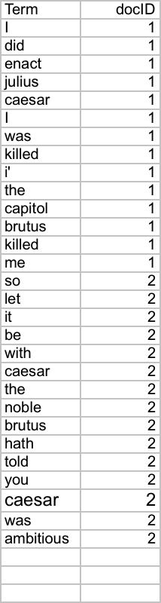
Indexer steps: Token sequence
Sec. 1.2
Sequence of (Modified token, Document ID) pairs.
Doc 1
Doc 2
I did enact Julius
Caesar I was killed
i’ the Capitol;
Brutus killed me.
So let it be with
Caesar. The noble
Brutus hath told you
Caesar was ambitious

Slide 7
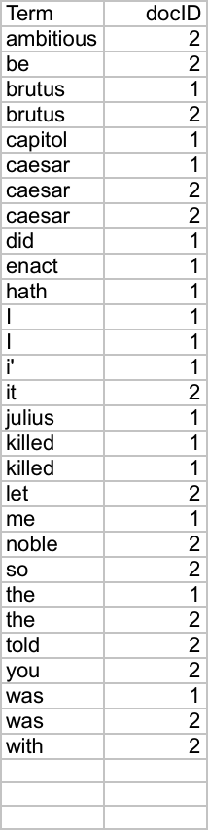
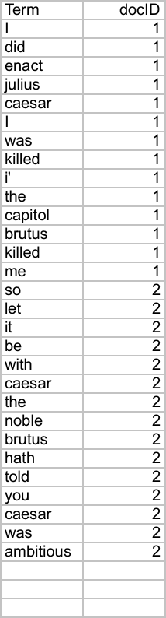
Indexer steps: Sort
Sec. 1.2
Sort by terms
And then docID
Core indexing step

Slide 8
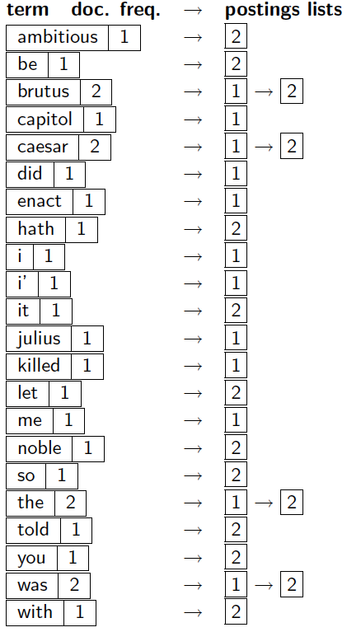
Indexer steps: Dictionary & Postings
Sec. 1.2
Multiple term entries in a single document are merged.
Split into Dictionary and Postings
Doc. frequency information is added.
Why frequency?
Will discuss later.

Slide 9
Where do we pay in storage?
Sec. 1.2
Lists of docIDs
Terms and counts
IR system implementation
How do we index efficiently?
How much storage do we need?
Pointers

Slide 10
The Inverted Index
The key data structure underlying modern IR

